Slide 1
Vet Tech Instruments

Slide 2
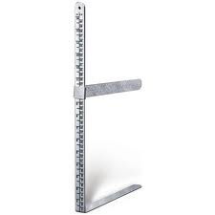

Slide 3
X-Ray Measuring Caliper

Slide 4
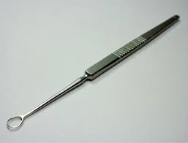

Slide 5
Lens Loop

Slide 6
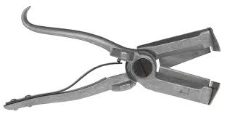

Slide 7
All-In-One Castrator, Docker and Ear Marker

Slide 8
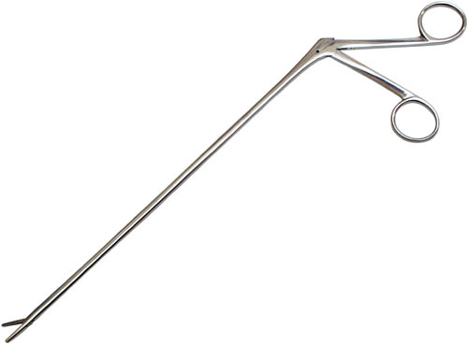

Slide 9
Alligator Forceps

Slide 10
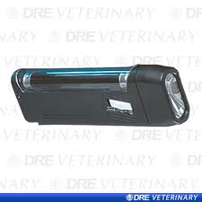
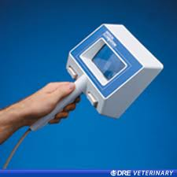

Slide 11
Wood’s Light

Slide 12
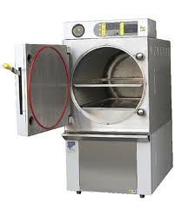
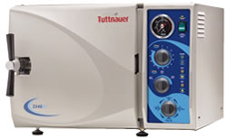

Slide 13
Autoclave

Slide 14
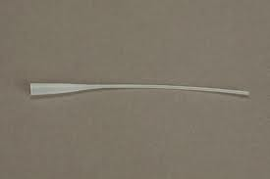

Slide 15
Tom Cat Catheter

Slide 16
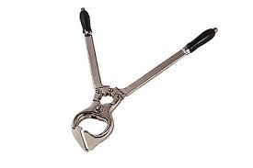

Slide 17
Burdizzo

Slide 18
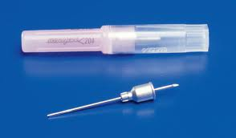

Slide 19
Transfer Needle

Slide 20
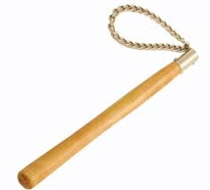

Slide 21
Twitch-Chain

Slide 22
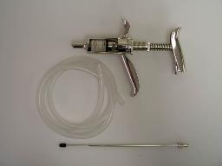
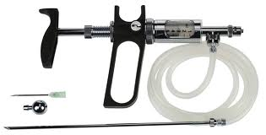

Slide 23
Veta-Matic Dose Syringe

Slide 24
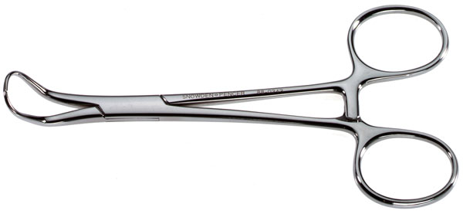

Slide 25
Backaus Towel Forceps

Slide 26
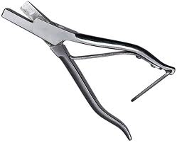

Slide 27
Ear Notcher

Slide 28
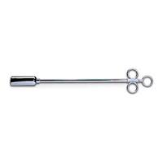

Slide 29
Balling Gun

Slide 30
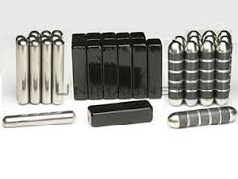

Slide 31
Rumen Magnet

Slide 32
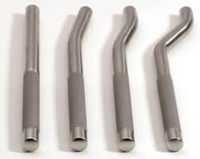

Slide 33
Dental Tooth Punch

Slide 35
Depth Probe and Explorer

Slide 36
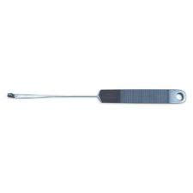

Slide 37
Cornell Teat Curette

Slide 38
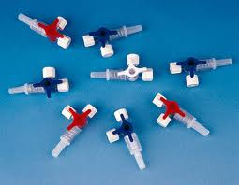

Slide 39
Three Way Stop Cock

Slide 40
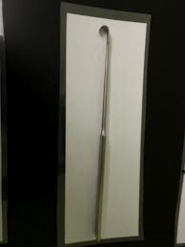

Slide 41
Spay Hook

Slide 42
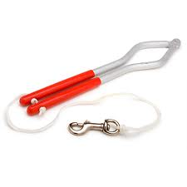
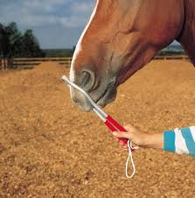

Slide 43
Twitch-Humane

Slide 44
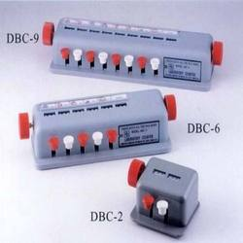
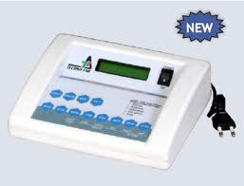

Slide 45
Differential Cell Counter

Slide 46
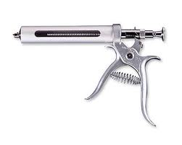

Slide 47
Automatic Dose Syringe

Slide 48
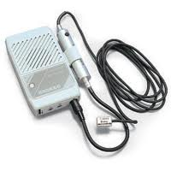

Slide 49
Doppler Ultrasonic Blood Flow Monitor

Slide 50
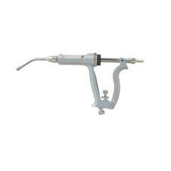
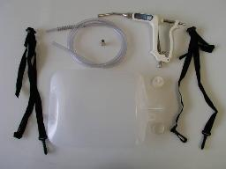

Slide 51
Drench-Matic Dose Syringe

Slide 53
Brown Adson Tissue Forceps

Slide 55
Fecal Loop

Slide 56
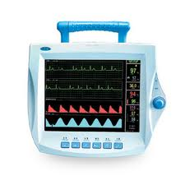

Slide 57
ECG Monitor Combination

Slide 58
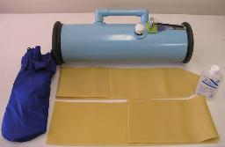
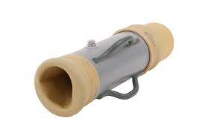

Slide 59
Artificial Vagina

Slide 60
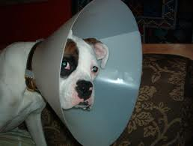

Slide 61
Elizabethan Collar

Slide 62
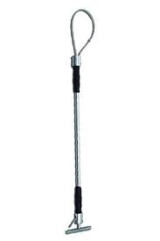

Slide 63
Dog Snare or Capture Pole

Slide 64
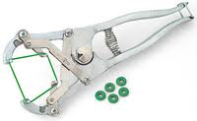

Slide 65
Elastrator

Slide 66
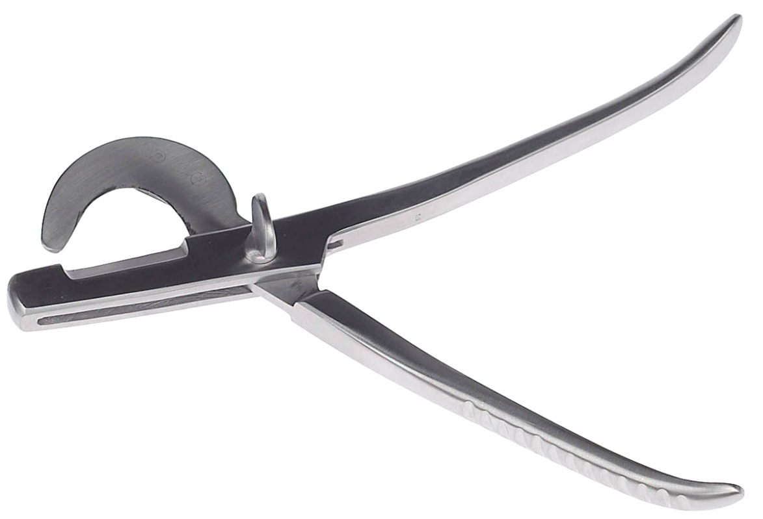

Slide 67
White Emasculator

Slide 68
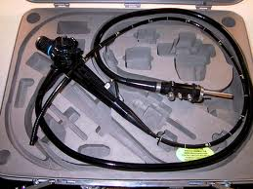

Slide 69
Endoscope

Slide 70
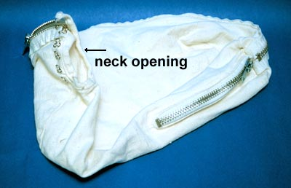

Slide 71
Feline Restraint Bag

Slide 72
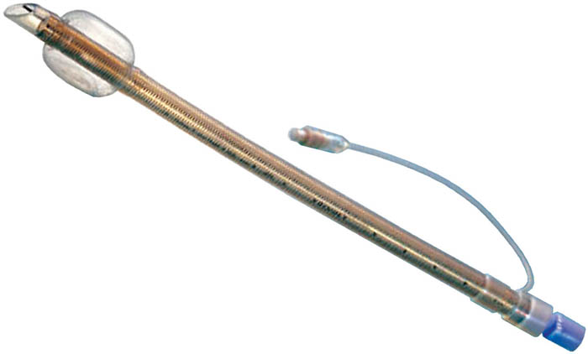
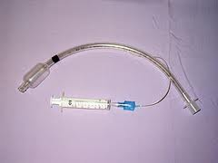

Slide 73
Endotracheal Tube

Slide 74
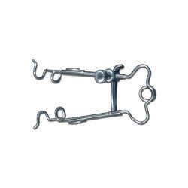
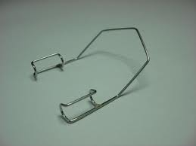

Slide 75
Eye Speculum

Slide 76
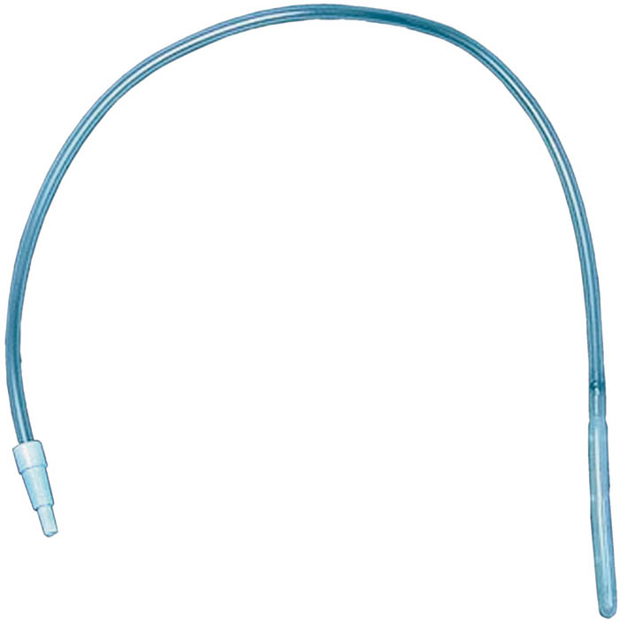
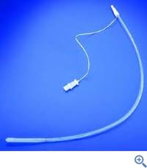

Slide 77
Esophageal Stethoscope

Slide 78
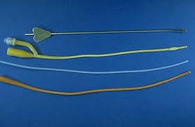

Slide 79
Female Canine Catheter

Slide 80
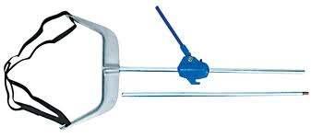

Slide 81
Fetal Extractor(Calf Puller)

Slide 82
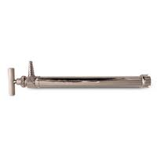

Slide 83
Drench Pump

Slide 84
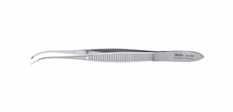

Slide 85
Half Curved Tissue Forceps

Slide 86
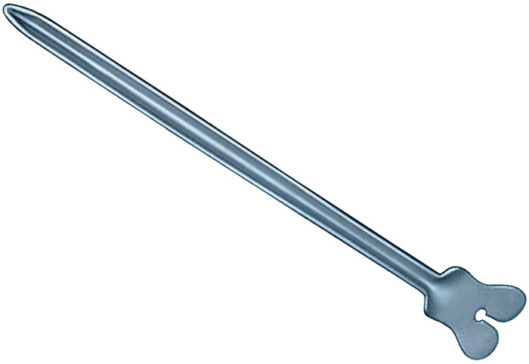

Slide 87
Groove Director

Slide 89
Guillotine Nail Trimmer

Slide 91
Half Circle Taper Point Suture Needle

Slide 93
Holzheimer Retractor

Slide 95
Halstead Mosquito Forceps
Curved
Straight

Slide 97
Hartman Mosquito Forceps
Straight
Curved
Handles are shorter
than on the Halstead

Slide 99
Hemacytometer

Slide 101
Stomach Tube

Slide 103
Forester Sponger Holding Forceps

Slide 105
Hoof Trimmer for Sheep and Goats

Slide 107
Horn Gouge

Slide 109
Identification Tag Applicator

Slide 111
Incisor, Canine, and Premolar Extracting Forceps

Slide 113
Mayo Scissors
Can be straight or Curved

Slide 115
Bulb Syringe

Slide 117
Insemination Pipette

Slide 119
Umbilical Clamp

Slide 121
Iris Hook

Slide 123
White Nail Trimmer

Slide 125
Jacquette Tarter Scaler

Slide 127
Kelly Forceps

Slide 129
Equine Molar Extracting Forceps

Slide 131
Lister Bandage Scissors

Slide 133
Intravenous Drip Set

Slide 135
Pig Tooth Nipper

Slide 137
Mayo-Hegar Needle Holder
The clamps on needle
holders will have raised
dots instead of lines
like on forceps.

Slide 139
Needle-Sterilizing Rack

Slide 141
Stethoscope

Slide 143
Olson-Hegar Needle Holder Scissor Combination

Slide 145
Operating Scissors

Slide 147
Ophthalmoscope

Slide 149
Silver Nitrate Stick

Slide 151
Spring Mouth Speculum or Gag

Slide 153
Tattoo Outfit Manual

Slide 155
Taylor Percussion Hammer

Slide 157
Pet Piller

Slide 159
Restraint Gloves

Slide 161
Oral Calf Drencher

Slide 163
Knowles Bandage Scissors

Slide 165
Otoscope

Slide 167
Killian Vaginal Speculum

Slide 169
Sphygmomanometer

Slide 171
Pill Splitter

Slide 173
Polansky Canine Vaginal Speculum

Slide 175
Half Circle Cutting Edge Suture Needle

Slide 177
Pole Syringe

Slide 179
Tarter Scrapers Single Ended

Slide 181
Reimer Emasculator

Slide 183
Refractometer

Slide 185
Scalpel Handle

Slide 187
Rectal Prolapse Ring

Slide 189
Barnes Dehorner

Slide 191
Bone-Plate Bender

Slide 193
Teat Slitter

Slide 195
Castroviejo Needle Holder with Catch

Slide 197
Dental Rasp

Slide 199
Ambu Bag

