Slide 1
Texas Vet Science CDE Breed List

Slide 2
Cattle Breeds

Slide 3
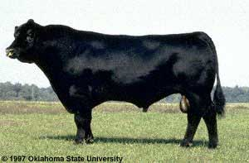
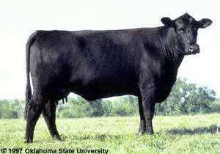
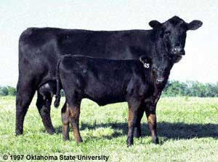

Slide 4
Angus

Slide 5
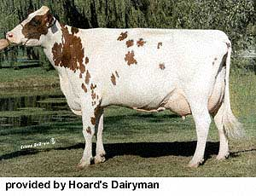
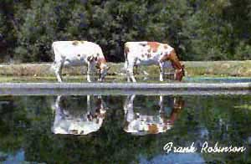

Slide 6
Ayrshire

Slide 7
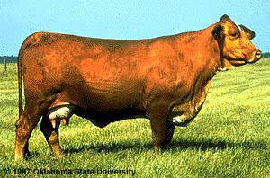
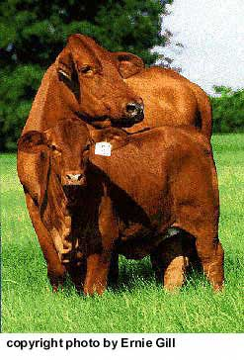
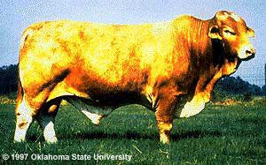

Slide 8
Beefmaster

Slide 9
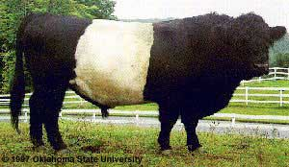
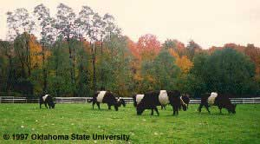
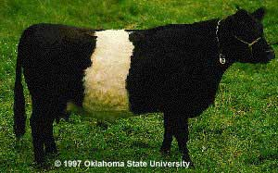
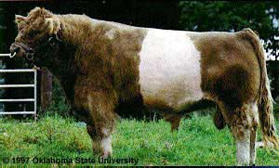

Slide 10
Belted Galloway

Slide 11
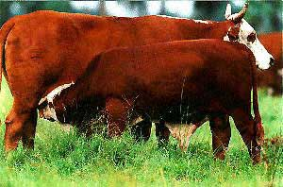
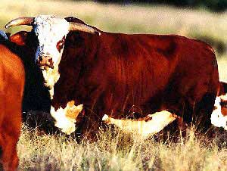

Slide 12
Braford

Slide 13
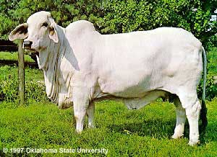
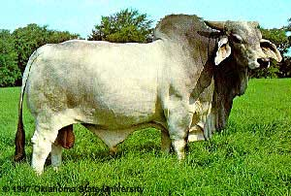
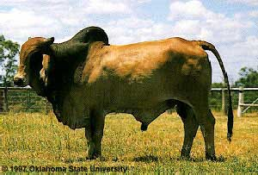
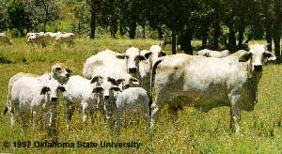

Slide 14
Brahman

Slide 15
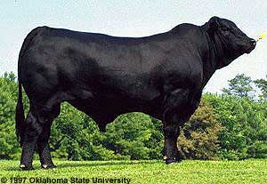
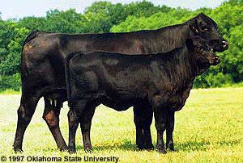

Slide 16
Black Brangus

Slide 17
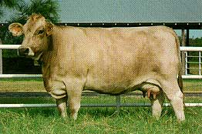
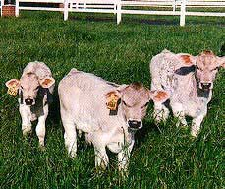
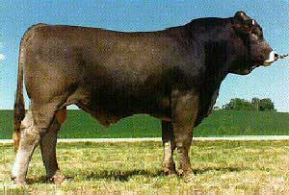

Slide 18
Braunvieh

Slide 19
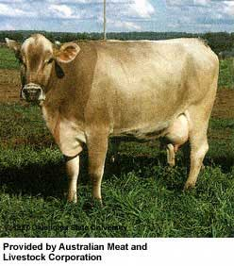
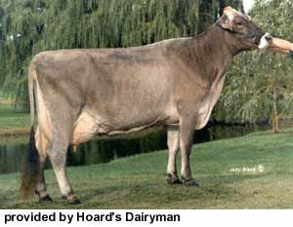
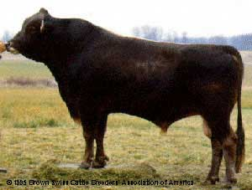

Slide 20
Brown Swiss

Slide 21
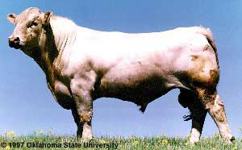
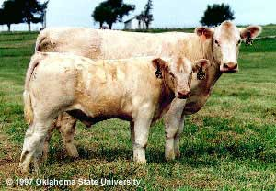

Slide 22
Charlolais

Slide 23
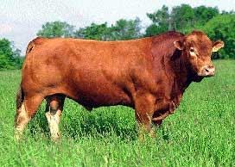
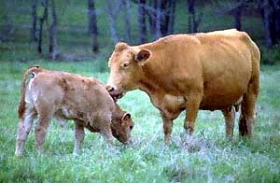

Slide 24
Gelbvieh

Slide 25
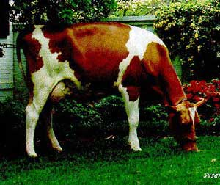
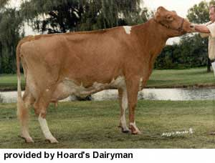
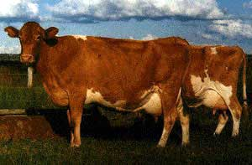

Slide 26
Guernsey

Slide 27
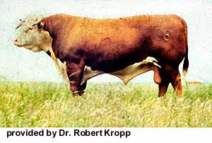
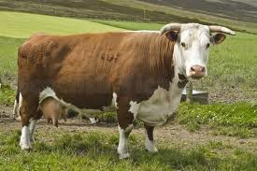

Slide 28
Hereford

Slide 29
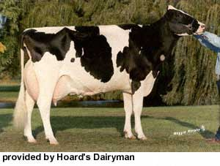
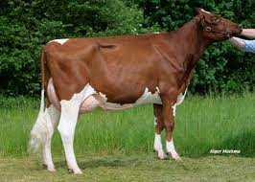

Slide 30
Holstein

Slide 31
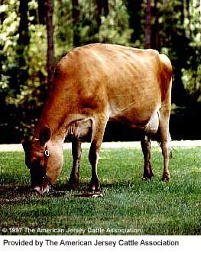
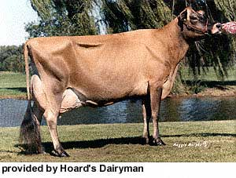

Slide 32
Jersey

Slide 33
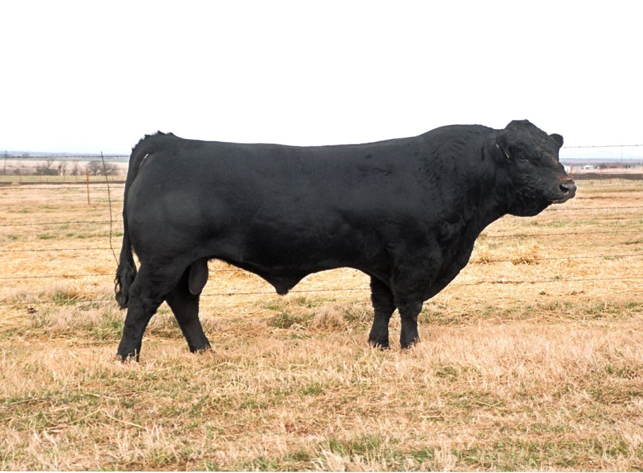
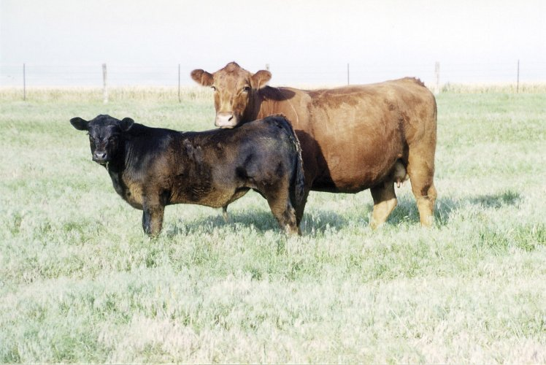
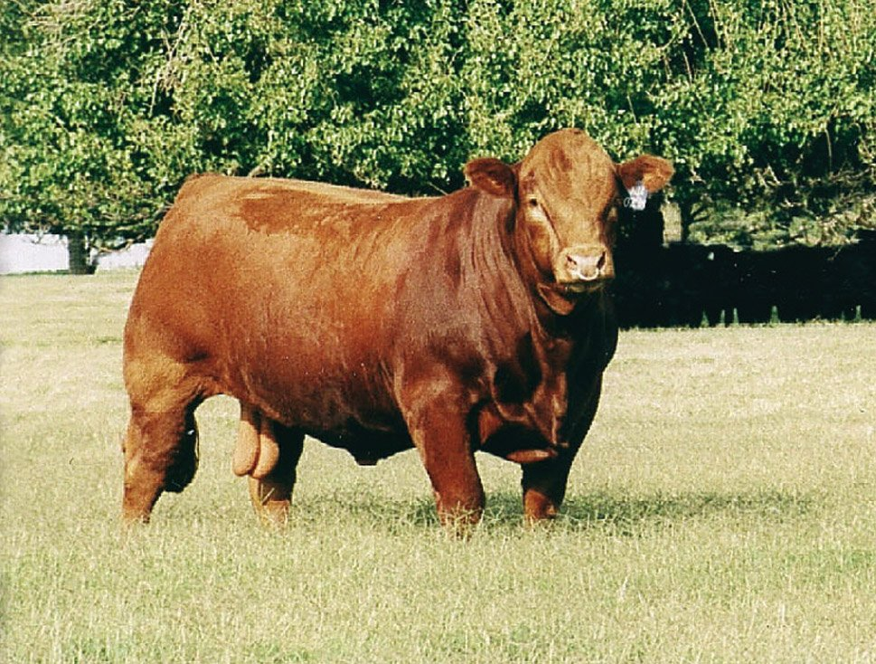

Slide 34
Limousin

Slide 35
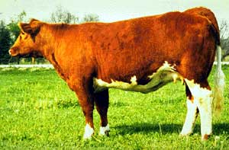
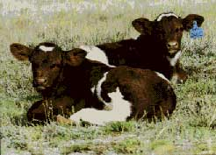
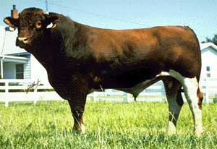

Slide 36
Maine Anjou

Slide 37
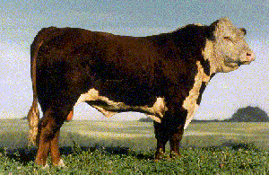
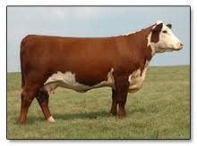

Slide 38
Polled Hereford

Slide 39
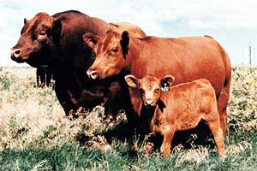
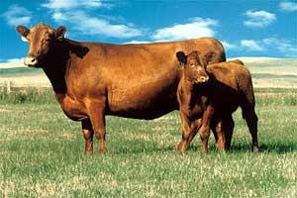
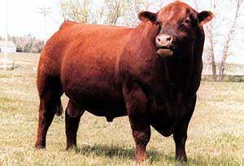

Slide 40
Red Angus

Slide 42
Red Brangus

Slide 44
Santa Gertrudis

Slide 46
Shorthorn

Slide 48
Simmental

Slide 50
Texas Longhorn

Slide 51
Horse Breeds

Slide 53
Andalusian

Slide 55
Appaloosa

Slide 57
Arabian

Slide 59
Belgian

Slide 61
Buckskin

Slide 63
Clydesdale

Slide 65
Dutch Draft

Slide 67
Dutch Warmblood

Slide 69
Friesan

Slide 71
Hackney

Slide 73
Hanovarian

Slide 75
Lipizzan

Slide 77
Miniature

Slide 79
Mustang

Slide 81
Paint

Slide 83
Palomino

Slide 85
Paso Fino

Slide 87
Percheron

Slide 89
Quarter Horse

Slide 91
Shetland Pony

Slide 93
Shire

Slide 95
Tennessee Walking Horse

Slide 97
Thoroughbred

Slide 98
Dog Breeds

Slide 100
Australian Cattle Dog

Slide 102
Bassett Hound

Slide 104
Beagle

Slide 106
Blood Hound

Slide 108
Border Collie

Slide 110
Boxer

Slide 112
Bulldog

Slide 114
Chihuahua

Slide 116
Chow Chow

Slide 118
Cocker Spaniel

Slide 120
Dachshund

Slide 122
Dalmation

Slide 124
Doberman Pinscher

Slide 126
English Cocker Spaniel

Slide 128
Golden Retriever

Slide 130
Great Dane

Slide 132
Labrador Retriever

Slide 134
Lhasa Apso

Slide 136
Pomeranian

Slide 138
Poodle

Slide 140
Pug

Slide 142
Rottweiler

Slide 144
Shetland Sheepdog

Slide 146
Shih Tzu

Slide 148
Welsh Corgi

Slide 150
Yorkshire Terrier

Slide 151
Cat Breeds

Slide 153
Abyssinian

Slide 155
American Curl

Slide 157
Balinese

Slide 159
Birman

Slide 161
Burmese

Slide 163
Color Point Shorthair

Slide 165
Cornish Rex

Slide 167
Devon Rex

Slide 169
Domestic Longhair

Slide 171
Domestic Shorthair

Slide 173
Egyptian Mau

Slide 175
Exotic Shorthair

Slide 177
Havana Brown

Slide 179
Maine Coon

Slide 181
Manx

Slide 183
Persian

Slide 185
Persian Himalayan

Slide 187
Russian Blue

Slide 189
Scottish Fold

Slide 191
Selkirk Rex

Slide 193
Siamese

Slide 195
Somali

Slide 196
Goat & Sheep Breeds

Slide 198
Angora Goat

Slide 200
Boer Goat

Slide 202
Spanish Goat

Slide 204
Barbado Sheep

Slide 206
Columbia Sheep

Slide 208
Dorper Sheep

Slide 210
Dorset Sheep

Slide 212
Hampshire Sheep

Slide 214
Ramboullet

Slide 216
Southdown Sheep

Slide 218
Suffolk

Slide 219
Swine Breeds

Slide 221
American Landrace

Slide 223
American Yorkshire

Slide 225
Berkshire

Slide 227
Chester White

Slide 229
Cross/Blue Butt

Slide 231
Duroc

Slide 233
Hampshire

Slide 235
Hereford

Slide 237
Pietrain

Slide 239
Poland China

Slide 241
Red Wattle

Slide 243
Spot

Slide 245
Tamworth

Slide 247
Vietnamese Potbelly

Slide 248
Exotics

Slide 250
Angora Rabbit

Slide 252
Ball Python

Slide 254
Burmese Python

Slide 256
California Rabbit

Slide 258
Chinchilla

Slide 260
Chinese Dwarf Hamster

Slide 262
Columbian Red Tailed Boa

Slide 264
Cockatiel

Slide 269
Cockatoo

Slide 271
Common Snapping Turtle

Slide 273
Desert Horned Lizard

Slide 275
English Lop Rabbit

Slide 277
Ferret

Slide 279
Gerbil

Slide 281
Green Tree Frog

Slide 283
Guinea Pig

Slide 285
Hedge Hog

Slide 287
Honduran Milk Snake

Slide 289
Iguana

Slide 291
Long Hair Teddy Bear Hamster

Slide 293
Lovebird

Slide 295
Mata Mata

Slide 297
New Zealand Rabbit

Slide 299
Parakeet

Slide 301
Prairie Dogs

Slide 303
Red Ear Slider

Slide 305
Savannah Monitor

Slide 307
Scarlett Macaw Parrot

Slide 309
Southern Flying Squirrel

Slide 311
Sugar Glider

Slide 313
Yellow Canary

